Slide 1
3D Human Activity Recognition with Reconfigurable
Convolutional Neural Networks

Slide 2
Outline
Background
Motivation
Framework
Results
Conclusion

Slide 3
Outline
Background
Motivation
Framework
Results
Conclusion

Slide 4
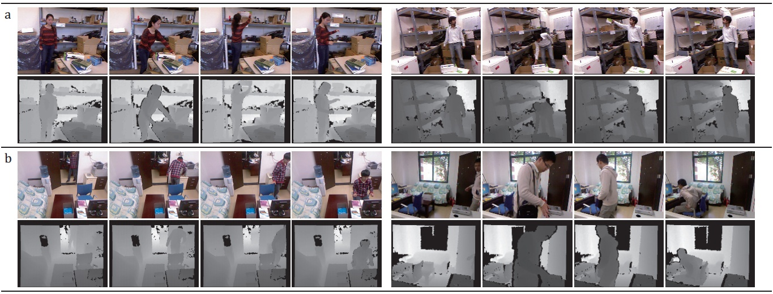
Background
Difficulties of complex human activity recognition
Representing complex human appearance and motion information.
Activity examples (diverse poses/views of individuals)
Notes:
1) It is usually hard to retrieve accurate body information with motions due to diverse poses/views of individuals.
2) depth maps are often unavoidably contaminated, and may become un-stable due to sensor noises or self-occlusions of bodies.
3) First row: two activity example from CAD 120 dataset, and two subjects perform the same activity (arranging-objects)
Second row: two activity example from proposed OA dataset, and two subjects perform the same activity (going-to-work)

Slide 5
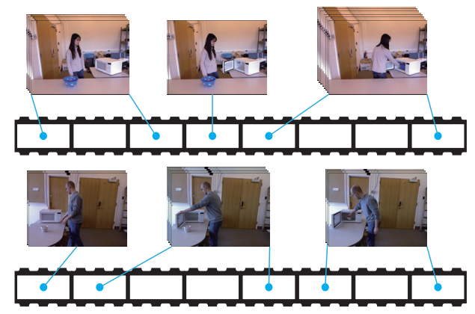
Background
Difficulties of complex human activity recognition
Capturing large temporal variations of human activities.
Variant
temporal
lengths
Activity = Temporal compositions of actions
Notes:
We consider one activity as a sequence of actions occurred over time.
(a) temporal compositions of actions are diverse by different subjects.
(b) the temporal lengths of decomposed actions are variant by different subjects
2) Figure is two activities of the same category performed by two subjects.

Slide 6
Outline
Background
Motivation
Framework
Results
Conclusion

Slide 7
Motivation
Deep architecture
Act directly on grayscale-depth data rather than relying on hand-crafted features.
Reconfigurable structure
Handle large temporal variations of activities via latent variables.
Notes:
We build the layered network stacked up by convolutional layers, max-pooling operators and full connection layers, where the raw segmented videos are treated as inputs.
2) Impose the latent variables to capture the temporal compositions of activities by manipulating the activation of neurons.

Slide 8
Outline
Background
Motivation
Framework
Results
Conclusion

Slide 9
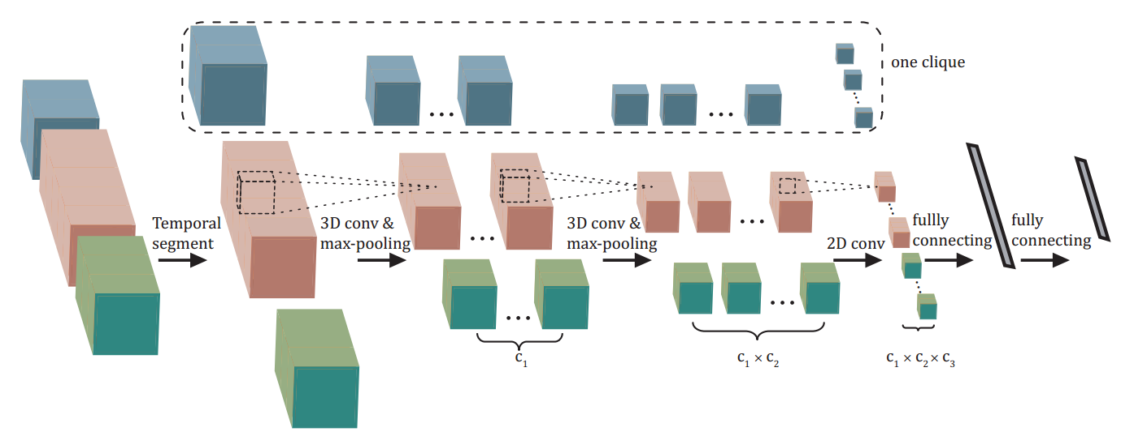
Deep Structured Models
Architecture
video segment of unfixed length
Notes:
The network is stacked up by convolutional layers, max-pooling operators and full connection layers, where the raw segmented videos are treated as the input.
2) A clique is designed as a subpart of the network stacked up for several layers, extracting features for one segmented video.
3) the architecture can be partially enabled to explicitly handle different temporal compositions of the activities.

Slide 10
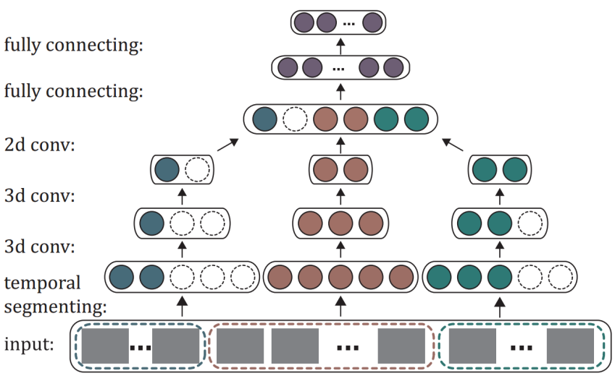
Deep Structured Models
Deep learning with reconfigurable structure
Incorporating the latent variables to manipulate the activation of neurons
Notes:
Different model cliques are represented by different colors.
As the temporal segmentation for an input video can be variant, different cliques might have different number of input frames.
For the cliques whose input frame number less than m, part of the neurons in the network are inactivated, as represented by the dotted blank circles.

Slide 11
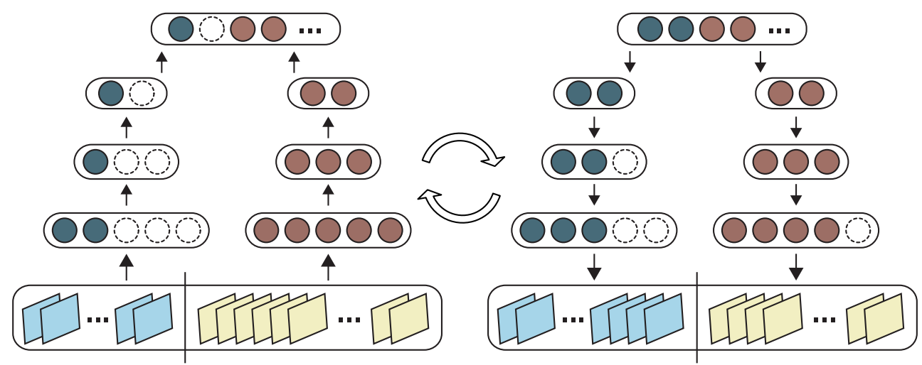
Deep Structured Models
Latent Structural Back Propagation Algorithm(an iterative algorithm with 2 steps):
Step 1: Given the current model parameters,
estimate the latent variables by adjusting the video segmentation.
Step 2: Given the estimated latent variables (inferring segmentation),
perform back propagation to optimize model parameters.
Note that the network neurons can be partially inactivated (as the dotted circles) according to the input segments.
Notes:
It is an iterative algorithm with two steps:
(a) Given the current model parameters, estimate the latent variables by adjusting the video segmentation;
(b) Given the estimated latent variables H which infers a video segmentation proposal, perform back propagation to optimize model parameters.
Note that the network neurons can be partially inactivated (as the dotted circles) according to the input segments.

Slide 12
Deep Structured Models
Model pre-training
Goal:
1) Handle the insufficient RGB-D data for training.
2) Boosting the activity recognition results.
More details:
Pre-train with 2D activity videos with labels (Supervised).
Discard the reconfigurability.
Apply standard back propagation to learn parameters.
Employ the learned parameters of the convolutional layers.
Notes:
2D activity videos can be easily accessed. For instance: MPII Human Pose Dataset (http://human-pose.mpi-inf.mpg.de/)
The pre-training steps:
a) Obtain large sum of 2D activity videos with labels.(a supervised manner).
b) Discard the reconfigurability of our deep structure model by segmenting the 2D videos evenly to the number as the number of model cliques.
(i) The initial model parameters are unstable, and it is not reliable to estimate latent variables H with them;
(ii) The training efficiency can be improved without considering the latent variables.
c) Apply standard back propagation to learn parameters.
d) Initialize our model with the learned parameters of the convolutional layers. (gray and depth channels share the learned parameters for the first 3D CNN layer. i.e., we enable gray channel of first 3D CNN layer only during 2D videos for pre-training. After that, we duplicate learned parameters of the gray channel to depth channel.)

Slide 13
Deep Structured Models
Inference
Perform the standard procedure of brute search for activity label and latent variables.
More details:
Given an activity label, we calculate its maximum probability by brute searching across all latent variables, i.e., all the temporal segmentations.
Search across all labels.
Choose the label with the maximum.
Accelerate the inference speed via Parallel computation. (0.4 second per video)

Slide 14
Outline
Background
Motivation
Framework
Results
Conclusion

Slide 15
Results
Dataset
CAD-120 activity dataset (120 videos, made by Cornell University)
Office Activity (OA) dataset. (1180 videos, newly created by us)
Challenge
large variance in object appearance, human pose, and viewpoint.
OA contains two subjects with interactions in two totally different scene.
Notes:
OA is nearly ten times larger than CAD-120.
1) The experiments are executed on a desktop with an Intel i7 3.7GHz CPU, 8GB RAM and GTX TITAN GPU. The source is in python with theano library.
2) For model learning, we set the learning rate as 0:002 for applying the stochastic gradient descent algorithm.
3) The training times of one fold are 2 hours for CAD-120 (including 120 videos and occupying 0.2GB), 5 hours for OA1(including 600 videos and occupying 1.0GB), and 5 hours for OA2 (including 580 videos and occupying 0.9GB) dataset, respectively.
4) Due to small training sample, CAD120 only has 120 long videos. We obtain many training videos by sampling the long video with equal stride. For instance, we divide one given video with 90 frames into three small videos with 30 frames via a stride of 3 sampling.

Slide 16
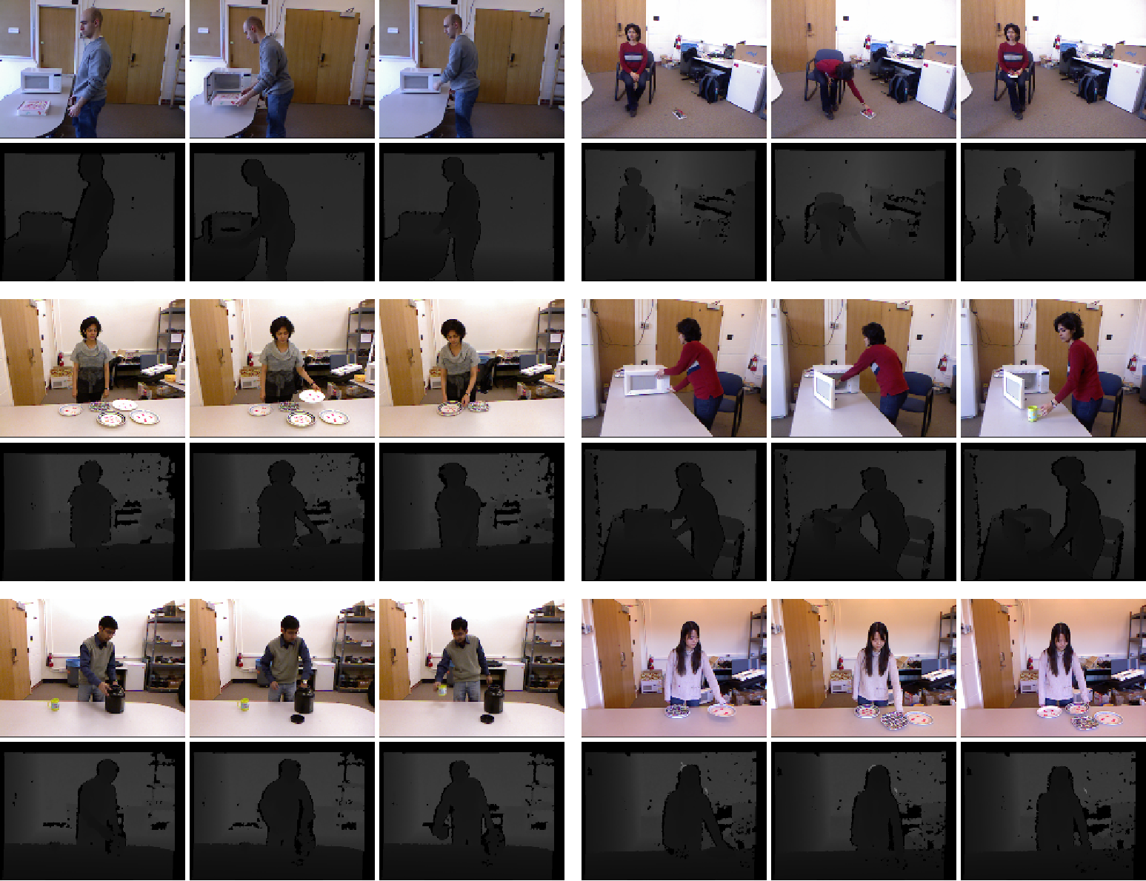
CAD-120
Notes:
CAD-120

Slide 17
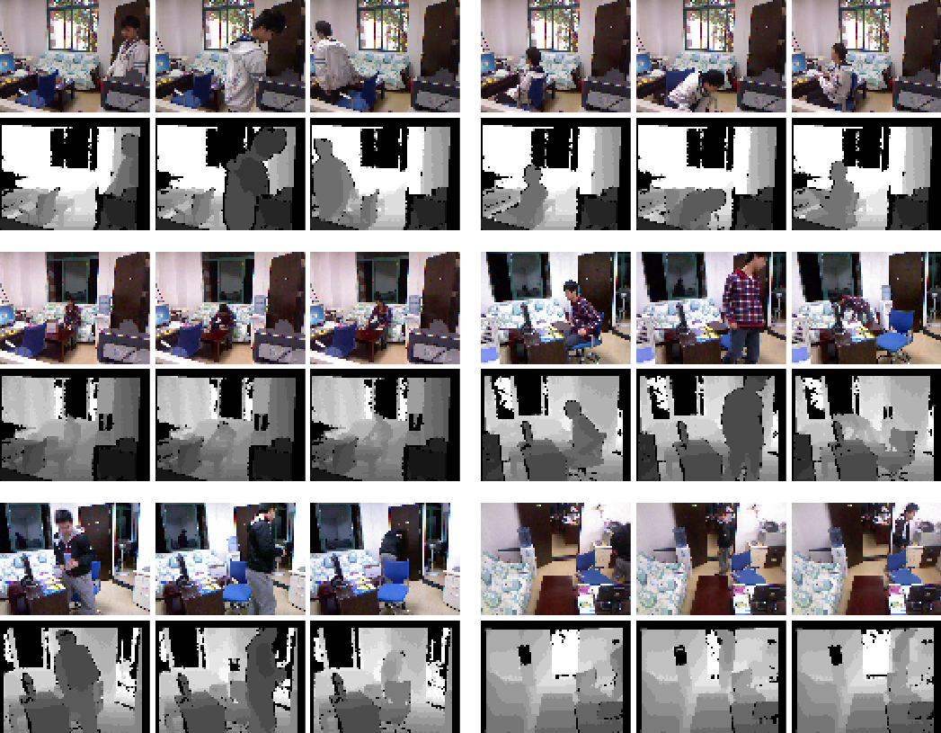
OA-1 (single subject)

Slide 18
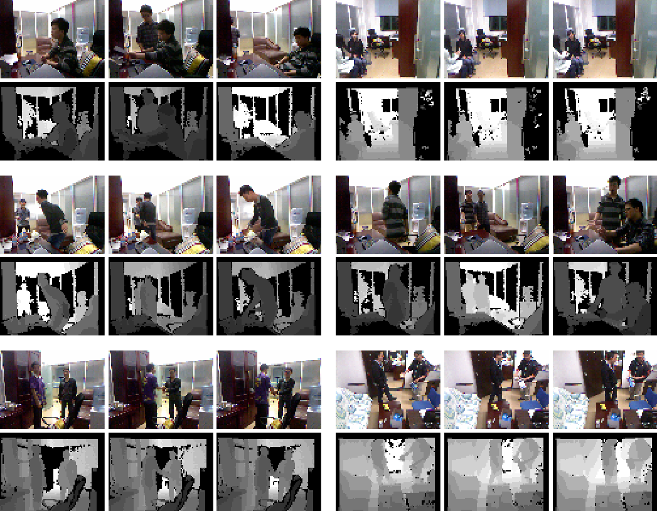
OA-2 (two subjects)

Slide 19
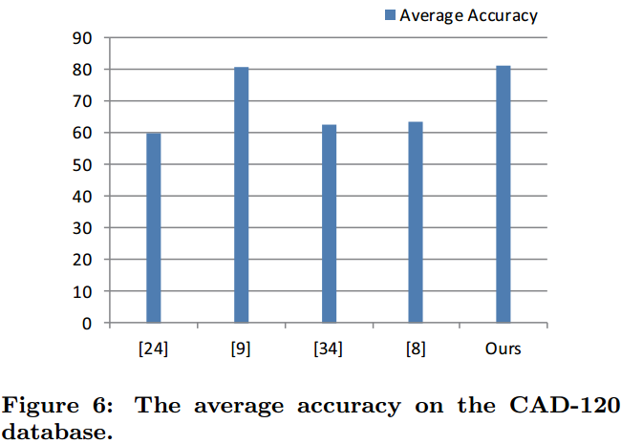
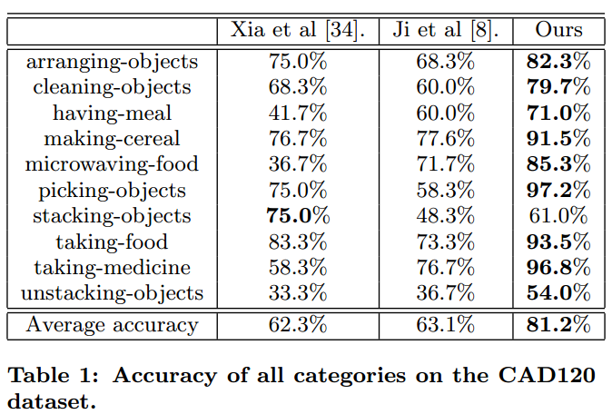
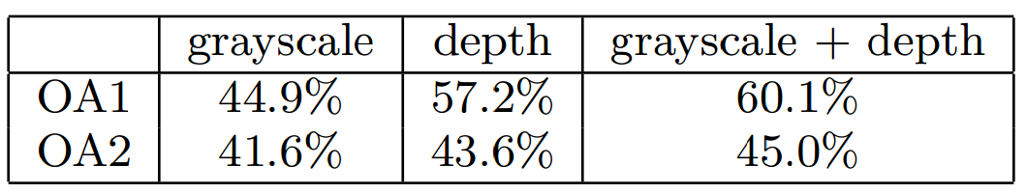
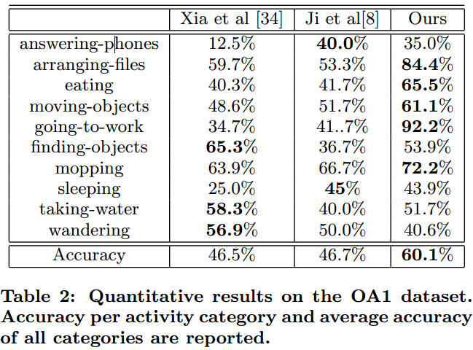
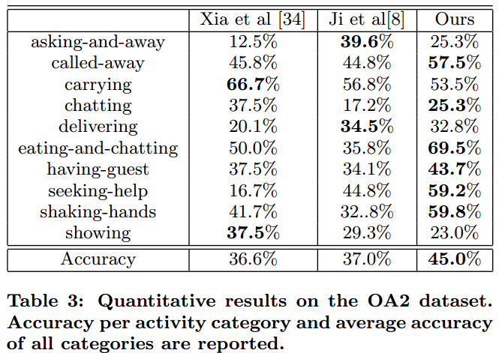
Experimental Results
Notes:
Our model obtains superior performance!
The depth data has much smaller variance, and does help to capture the motion information.

Slide 20
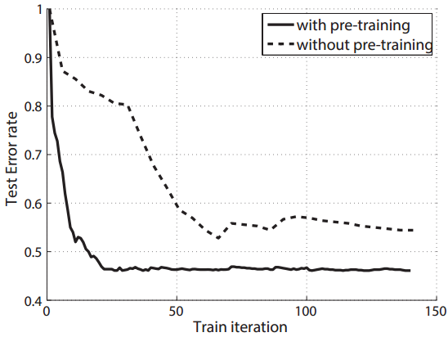
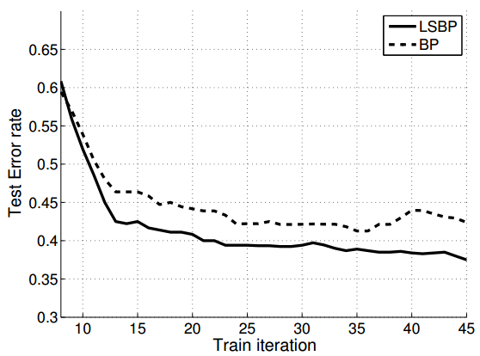
Empirical Analysis
With/without using the pre-training
With/without incorporating the latent structure
Notes:
This experiment is executed on the OA1 dataset.
Test error rate is one minus the classification accuracy.
1) It is shown that the model using the pre-training converges after 25 iterations, while the other
one without the pre-training requires 140 iterations. More importantly, the pre-training can effectively reduce the error rate in the testing, say 8% less than without the pre-training.
2) We observe that the error rates of the structured model decrease faster and reach to the lower result,
compared with the non-structured model.

Slide 21
Outline
Background
Motivation
Framework
Results
Conclusion

Slide 22
Conclusions
Recognition from raw RGB-D data rather than relying on hand-crafted features
Incorporating model reconfigurability into layered convolutional neutral networks
Handling well realistic challenges in 3D activity recognition

Slide 23
Thank you!

